Slide 1
Project Management
Application for Restaurant

Slide 2
Team Members
Ahmed Magdy
Ahmed Abdalla
Ahmed Abdelaziz
Ahmed saad
Tayam Alaa
Adham Ahmed

Slide 3
In application we can control everything about the restaurant for example :cashier ,staff entry and exit times and determine their salary.

Slide 4
Project Charter
A project charter formalizes the goal and serves as a map to the destination. Above all, however, a project charter formally authorizes the project.

Slide 5
Project system : application for restaurant
Project sponsor : marvel studio ,DC and nageb swirs
Project manager: ahmed mekky
Project team : ahmed abdalla , ahmed abdelazez, ahmed magdy, tayam alaa , ahmed saad and adham ahmed.
Project purpose: in application we can control everything about the restaurant for example :cashier ,staff entry and exit times and determine their salary.
Business case: pen and paper and calculator have served this restaurant since 1980 but it is time to let it go we will have a full system would help us not with entry and exit of workers no but with every single thing from the single fork to the tables and food it will allow us to save a lot of time and money and to be more secure and more productive a simple example when a worker come to work in 8 a m he will put his finger print on the computer by the scanner and the system will save the time he came and do the same when he leave and the system will count his legal time as known as 8 hours and start to count his salary all over the month and if he worked more then 8 hours the hour will be determined as 2 hours in the system and will be added to his salary .

Slide 6
The system will count how many customers came today so he will count how many forks and knives need to clean today .
To the food items the we will give the system like how many do we need in a month from everything in the kitchen starting from tomato to the beef and chickens we need in a month and the system will count how many we used and how many we still have instead of counting it ourselves .the chashier will be ready with all the dishes we have in the restaurant and every drinks on a tablet with the waiter which is connected with the chashier pc by a network and the system will count the check by the tables numbers it will help us a lot and saves a lot of efforts , time and money .
Project results
completely successful by january.
It saves 300,000 $ by a year .
Project milestone timeline
September : workers will know about the application.
October : everyone starts to get use to the system .
November : receive the feedback on the application, and fix the problems if exist
December : the whole staff is an experts in using the system and very happy to save efforts and time .

Slide 7
Project resources
1.Sidi bishr lab in 63 street .
2.The world site of develop systems.
3.site : How to Create Restaurant Apps. The Complete Guide.
Project constraints , assumptions , and risks
The project must be done by january the third
It will cost 20,000 $ and must not exceeded 30,000 $
The risk the worker will not accept the application and don’t use it

Slide 8
Project Scope
This document defines all of the deliverables the project will create, the boundaries of the project, and the work that the project team will need to complete in order to create the project deliverables. This document is based on the project requirements, the feasibility study, the business goals and objectives, and the business case document

Slide 9
1-Project Scope Description:
It’s an Application Use to Control System in a Restaurant for example :cashier , make customers order from the app ,staff entry and exit times, and determine their salary.
2- Project acceptance criteria:
Easy to use, faster and comfortable.
Beautiful user interface.
Save time and effort.
3- Project deliverables:
Project plan, reports, documents and resources which return to the owner.
Improve the application.
Presents the offers for using the app.

Slide 10
4- Project exclusions:
put limit the minimum charge to make an order
5- Project constraints:
Cost must not exceeded 30,000 $.
The app not take more than 5 months.
Rules of polices and trade.
6- Project assumptions:
There will be an increase in profit after the first year.
After the success of the program, it can be sold to more than restaurant after modifying it.

Slide 11
Work Breakdown Structure
A WBS is a deliverables-oriented
collection of project components. It is a categorization and decomposition of the
project scope statement. you’re breaking
down the massive project scope statement into smaller, more manageable component

Slide 12
1-Project Plan:
Specify goals and ideas.
Know the requirements of the project.
Do a feasibility study for the project.
2- Project Budget:
Program design costs.
Looking at the program's tax fees.
Salaries of program employees.
3- Project Execution:
Specify inputs, outputs and information processing .
Design the interface of the project.
Test the project system.
4- Project Finish:
Explain and fixed errors of the project.
Install the app in all devices in restaurant.
Make the propaganda for the project in all different platforms.
Receive the feedback on the application.

Slide 13
WBS Dictionary
dictionary is a great place to define each element of the WBS in simple-to-understand terms that all project team members and stakeholders can reference.

Slide 14
The project plans
firstly we will specify goals and ideas such as we what do we need this app and what ideas and staff will be in the app and how will we use it .
secondly we will manage to know the requirements of the project from all fields such as the cost , the developers and the sponsor …etc.
thirdly we will study every side of the project to make it as good as possible to be easy as possible to use .
project budget
firstly we will discuss and put the program designs costs and we will discuss the contents of the designs .
secondly we will look at the program tax fees.
Thirdly we will discuss about the employees salaries who will help us in creating the application .

Slide 15
Project execution
First move will be that we will specify the input which we are going to take it from the user and the output which we will give it to the user again after processing the information we will have .
Second we will discuss the design of the interface of the project and make it as good as possible.
Thirdly the zenworks expert will test the project system and say every single note about it.
Project finish
After the test of the project we will explain the errors and fix it all in the project .
And the will do a network on the restaurant and we will install the app on all devices in the restaurant which will be connected together on the network .
And we will make the propaganda for the project in all different platforms as internet , ads on tv. and ads in real life .
Finally we will receive a feedback for the app and we will try to make as perfect as possible and easy for any user.

Slide 16
Roles and Responsibilities Matrix
responsibilities matrix is a method to identify all of the roles within a project and the associated responsibilities to the project work.responsibilities matrix can help the project manager identify the needed resources to complete the project work—and determine if the resources exist within the organization’s resource pool.

Slide 17
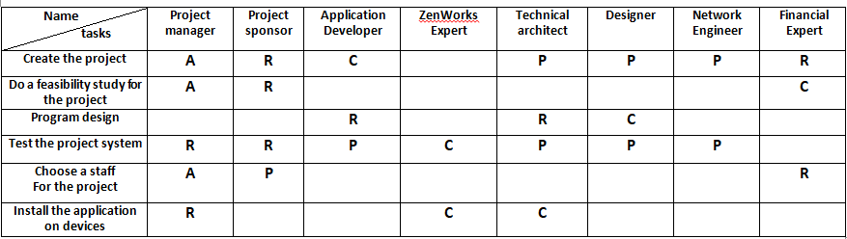
A = Approves R = Reviews P = Participant C = Creator

Slide 18
Project Network
Project networks are developed from the WBS. The project network is a visual flow diagram of the sequence, interrelationships, and dependencies of all the activities that must be accomplished to complete the project.

Slide 19
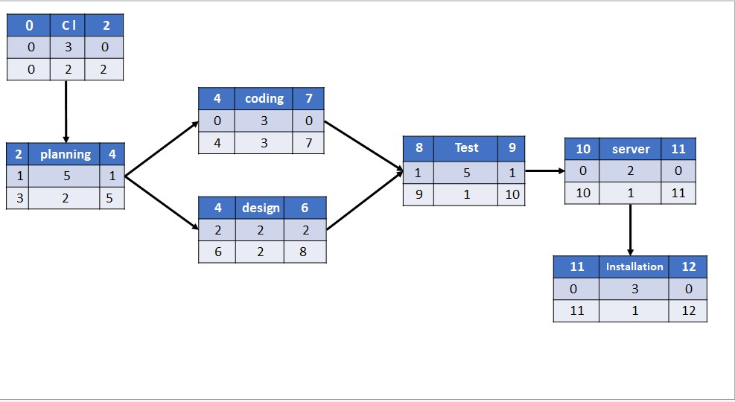

Slide 20
Resource Constrained Schedule
resource-constrained project is one that assumes the level of resources availlable cannot be exceeded. If the resources are inadequate, it will be acceptable to delay the project, but as little as possible

Slide 21
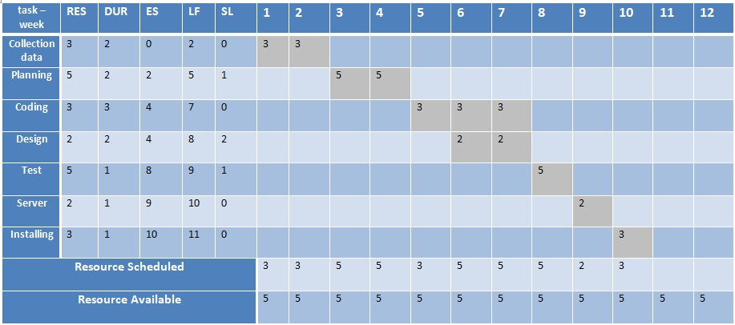

Slide 22
Budget
you can time-phase work packages and assign them to their respective scheduled activities to develop a budget schedule over the life of your project.

Slide 23
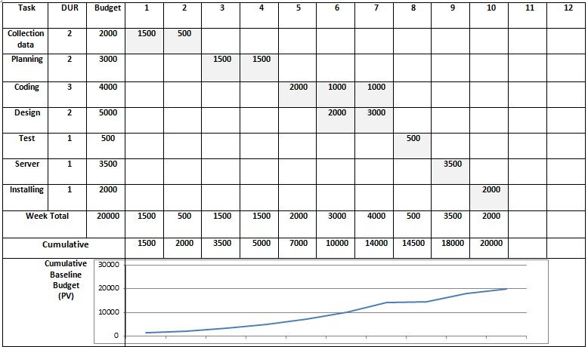

Slide 24
Risk Management
The risk management plan is a component of your overall project management plan that details how project risks will be identified, analyzed, responded to, and controlled. Risk management happens throughout the project, and you and the project team should always be on the lookout for new risk events.

Slide 25
Don’t determine the enough budget to create the project. A feasibility study for the project must be excellent so all project requirements should be studied, and the adequate budget must be determined.
Don’t specify all potential expectations of the program, as it may not implement the project's purpose.
Ignoring to choose the suitable interfaces for the serenity of customers so designs must be chosen carefully.
Don’t expect the conditions of workers on the program (such as illness or fatigue), so more than one worker must be provided for one task.
Don’t provide sufficient and appropriate information for the project so must to determine enough and suitable plans before starting.
A Technical error in the devices used to create the program, so the devices must be checked before starting.

Slide 26
اعضاء المجموعة
احمد مجدي محمد
تيام علاء الدين السعيد
احمد عبدالله مصطفي
احمد عبدالعزيز عبدالباري
احمد سعد سعد المهدي
ادهم احمد حسين

